Slide 1
Virtual Autonomous Vehicle Simulator
Sam Vatany
Kegan van Ginkel
Henry Paek

Slide 2
System Metaphor
This software allows the user to drive through a city with simulated traffic. The traffic, vehicles and pedestrians, will be guided by traffic lights and by random paths. The simulator will collect data using machine learning and display it to the user.

Slide 3
Process
Work coordination
Regular meetings on Friday/Monday
Discussion about functionality, integration, etc.
Divide work activities
General process:
Individual work (assigned work activities)
Integrate product/change through github
Test updated functionality by running simulation
Version control
Github-Unity environment

Slide 4
Cycle 3 Intent
Modify AI vehicle implementation using Deep Q-learning.
Set up an AI car agent and a camera sensor for the development of AI vehicles through Deep Q-learning.
Developing traffic light animation newly in Unity

Slide 5
User Story: Camera Sensor
Summary: As a user, I would like to be able to train the AI vehicles using a camera placed on top of the car to gather input data for the deep Q-learning model.
Description: The camera sensor captures every frame and encodes the frame as a JPEG. The encoded frame is then available as a byte array for the deep Q-learning model.
Planned Hours: 3
Actual Hours: 3
Coder(s): Sam Vatany
Tester(s): Sam Vatany
Status: Complete

Slide 6
User Story: AI Car Agent
Summary: As a user, I would like an AI vehicle that is able to receive and send information to the deep Q-learning model.
Description: On request, the agent logs its current steering, throttle, brake, velocity, acceleration, and location values. It also will modify its throttle, brake, and steering values based on the output from the deep Q-learning model.
Planned Hours: 6
Actual Hours: 9
Coder(s): Sam Vatany
Tester(s): Sam Vatany
Status: Complete

Slide 7



Light animation in Unity
Platform: Blender -> Unity
Keyframe-only animation is unable to export from Blender to Unity (Bone/armature animation required)

Slide 8
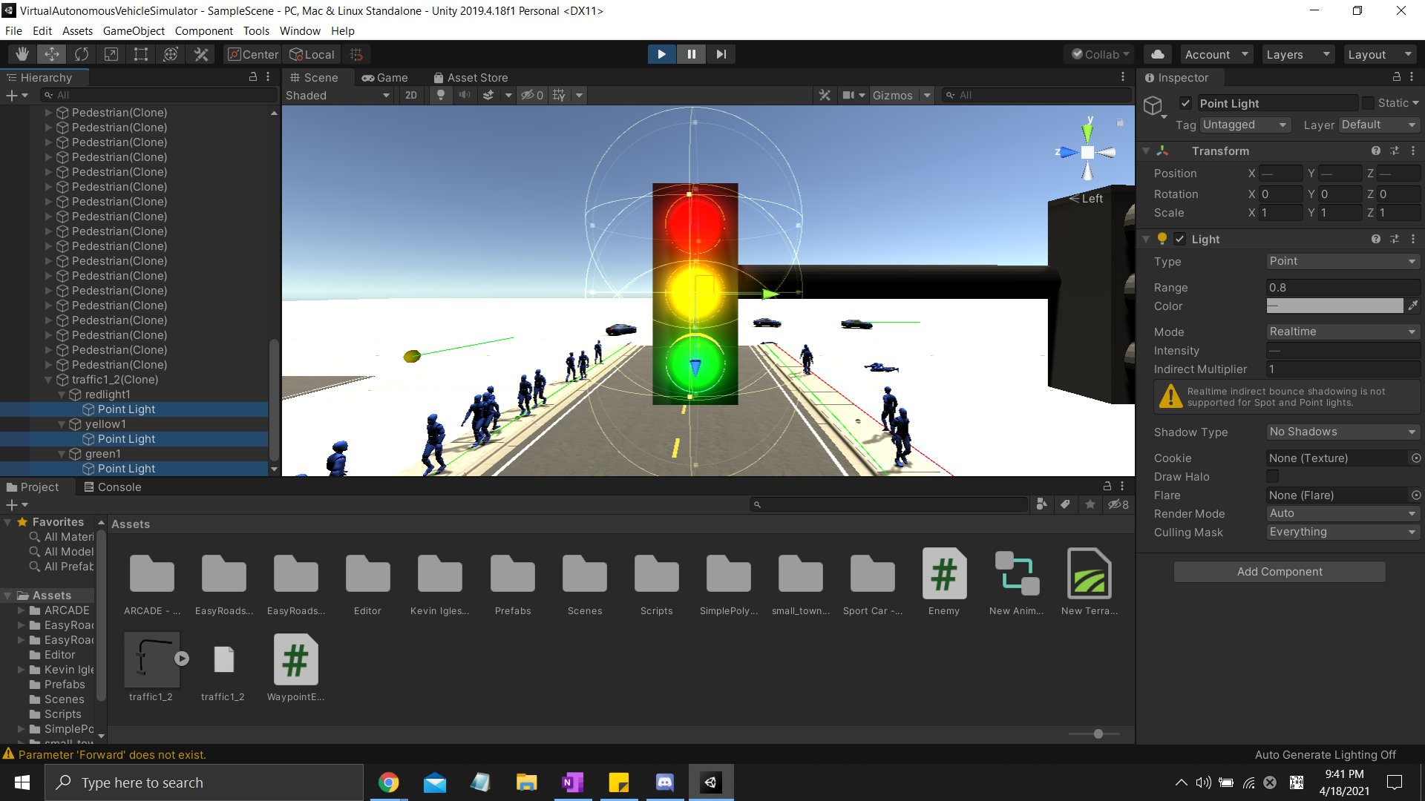
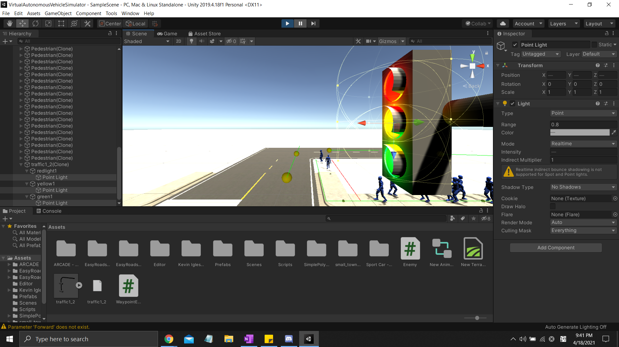
Design Highlight: Light animation in Unity (Continued)
Controller needed for managing length, phase/pattern of lights

Slide 9
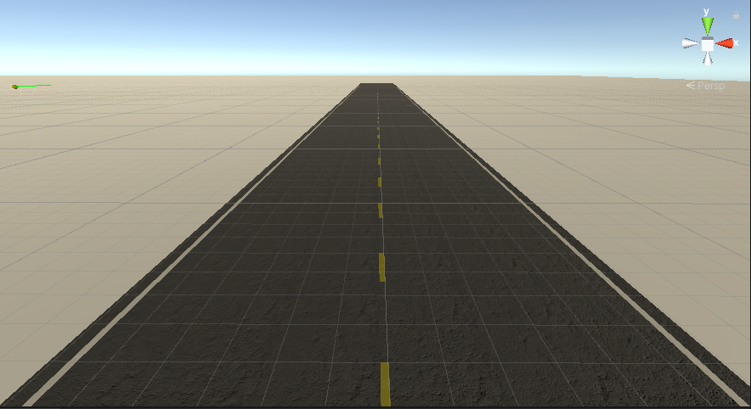
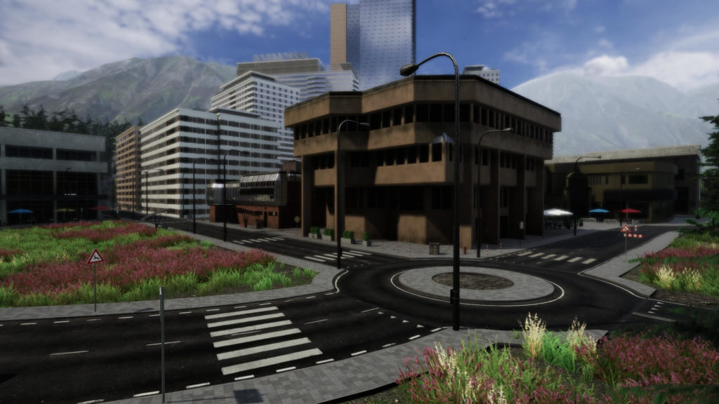
User Story: Intersection/City
Summary: As a user, I would like to have a road system/city to traverse through.
Description: The user will have a city he/she could drive through with traffic lights to guide AI cars/pedestrians.
Planned Hours: 20
Actual Hours: 6
Coder(s): Kegan van Ginkel
Status: In Progress
Notes:
This is the base example of a scenario for test/training the deep q-learning. In this example the goal is to get the car to stay in its lane. Other scenarios could be for things like turning and avoiding collisions.

Slide 10
Plans For the Future
Be able to send inputs to car agent in Unity from Jupyter
Ex: accelerate, brake, turn left, turn right
Alternatively, develop deep q-learning model in Unity
Create basic reward/punishment system for training in simple scenario (such as staying in the right lane)

